Slide 1
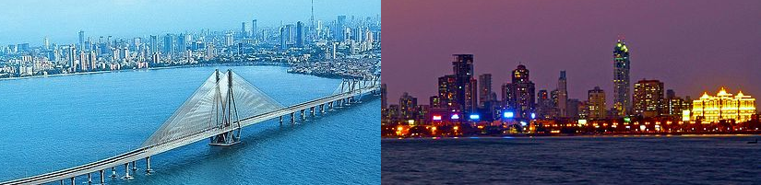
IBM Capstone Project Opening a shopping mall in Mumbai (India)
Rohit Garg
March 2020

Slide 2

Introduction
Business problem
Target audience
Mumbai (also known as Bombay the official name until 1995) is the capital city of the Indian state of Maharashtra. According to United Nations, as of 2018, Mumbai was the second most populous city in India after Delhi and the seventh most populous city in the world with a population of 19.98 million
A shopping mall is a modern term for a form of shopping precinct or shopping center in which one or more buildings form a complex of shops with interconnecting walkways, usually indoors. From the late 20th century, entertainment venues such as movie theaters and restaurants began to be added. As a single built structure, early shopping centers were often architecturally significant constructions, enabling wealthier patrons to buy goods in spaces protected from the weather.
Location plays an important role in the success of a shopping mall. In this exercise we will analyse the best location/s to open a shopping mall in Mumbai (India).
This analysis will be very helpful for property developers and investors looking to open a shopping mall in Mumbai (India).
Data
List of neighbourhoods in Mumbai
https://en.wikipedia.org/wiki/Category:Suburbs_of_Mumbai
Co-ordinates of these neighbourhoods
Python – geocoder package
Venue data
Foursquare API

Slide 3
Methodology
Get data from Wiki
Get neighbourhood information from Wikipedia page
We will do web scraping using beautiful package
Get coordinates
We will use the geocoder package
Create dataframe containing the neighbourhood and the corresponding coordinates
Get coordinates for Mumbai
We will use the geocoder package
The geograpical coordinate of Mumbai, India: 18.9387, 72.8353
Foursquare - top 100 venues in a radius of 1000 meters
We will use the Foursquare API to get the top 100 venues in a radius of 1000 meters (1 km).
We will make API calls to Foursquare by passing the geographical co-ordinates
We will do one-hot encoding for each venue category
Then we will analyse each are by taking the frequency of occurrence of each venue
Next we will perform k-means clustering
We will cluster neighbourhoods into 3 clusters based on the frequency of occurrence for "Shopping Mall"
Cluster map
We will use the folium package
The map will help us to answer which neighbourhood is best for opening the shopping mall
Analyse each area
Cluster Areas - kmeans

Slide 4
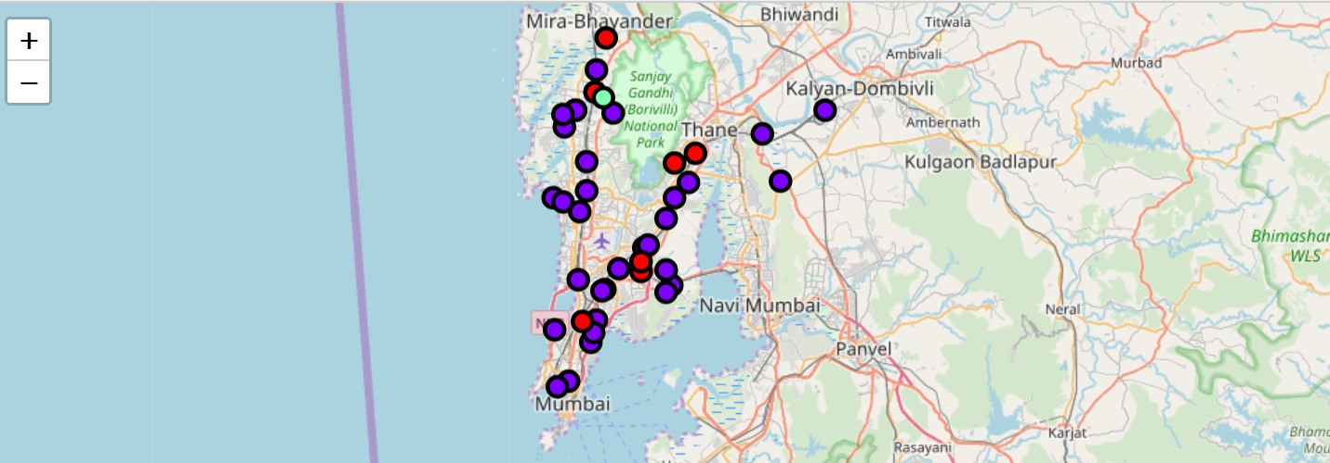
Results
The k-means clustering algorithm creates 3 clusters
Cluster 0 (in blue – ref above map): No shopping mall
Cluster 1 (in red – ref above map): Moderate concentration of shopping mall
Cluster 2 (in green – ref above map): High concentration of shopping mall

Slide 5
Discussion
Neighbourhood | Shopping Mall | Cluster Labels | Latitude | Longitude
Borivali | 0.021277 | 1 | 19.22936 | 72.85751
Juhu | 0.02439 | 1 | 19.01492 | 72.84522
Chembur | 0.02439 | 1 | 19.06218 | 72.90241
Pestom sagar | 0.025641 | 1 | 19.07064 | 72.90217
Mulund | 0.030303 | 1 | 19.17183 | 72.95565
Mira Road | 0.041667 | 1 | 19.280032 | 72.867932
Sonapur, Bhandup | 0.034483 | 1 | 19.16394 | 72.93544
Most of the shopping malls are located in the dense residential areas with the highest concentration in cluster 2 and lowest in cluster 1. There is good opportunity to open shopping mall in cluster 1:
cluster 2 - likely tough competition
cluster 0 - likely low demand
Therefore we recommend property dealers and investors to look for opportunities for the neighbourhoods that are in cluster 1.

Slide 6
Limitations
Recommendation and Conclusion
We considered only the density of shopping malls in a particular neighbourhood. The following limitations were identified:
Other factors such as ease of transportation, average income of the neighbourhood, average spending of the neighbourhood, etc were studied.
We could have also converted this study into a supervised learning algorithm (propensity of mall is determined by various factors) rather than limiting ourselves to unsupervised learning algorithm (that is k-means).
In this project we have addressed the question – analyse the best location/s to open a shopping mall in Mumbai (India). This analysis will be very helpful for property developers and investors looking to open a shopping mall in Mumbai (India).
The neighbourhoods in cluster 1 are the most preferred locations to open a new shopping mall.
THANK YOU

